Slide 1
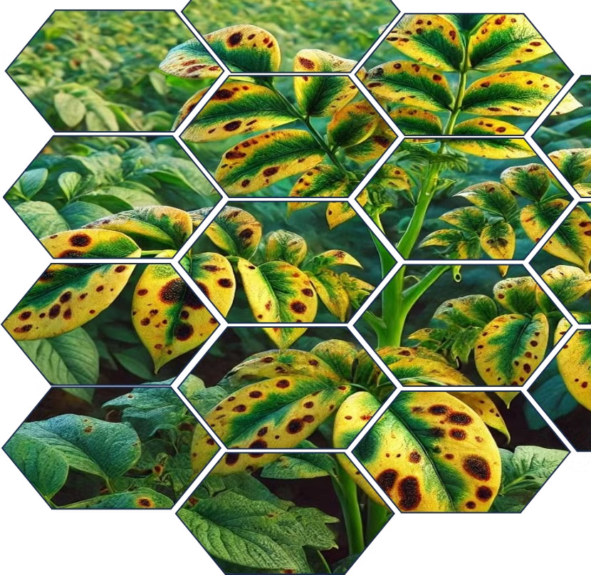
Potato Disease Detection Web
A website for Early Blight and Late Blight Identification using CNN.

Slide 2
Our Project Team
Roll No. :
Name :
01
Aachal Badjate
10
Niharika Nashine
Akshat Sharma
Atharva Shakargayen
28
31
Om Zawar
Guided By:
45
Dr. Supriya Gupta Bani

Slide 3
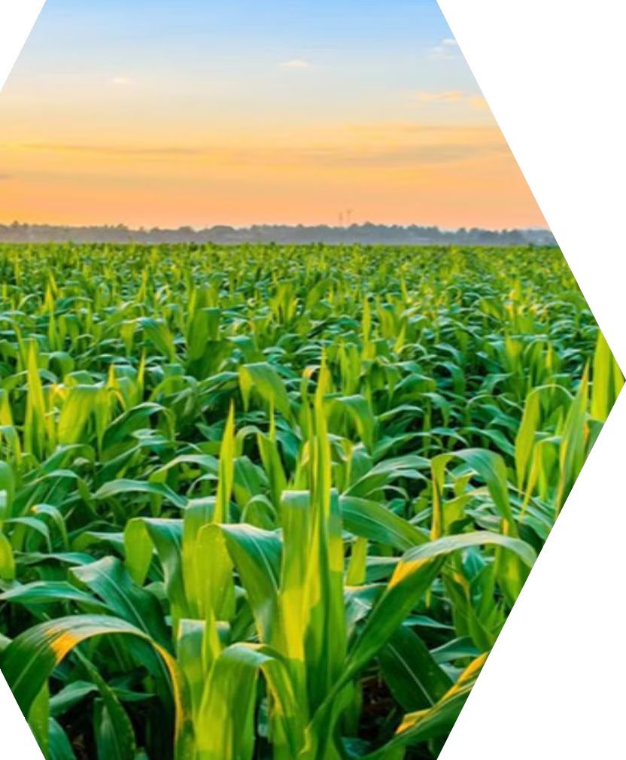
Index
Introduction Problem Definition Project Description
Project Outcomes
Test Case Conclusion

Slide 4

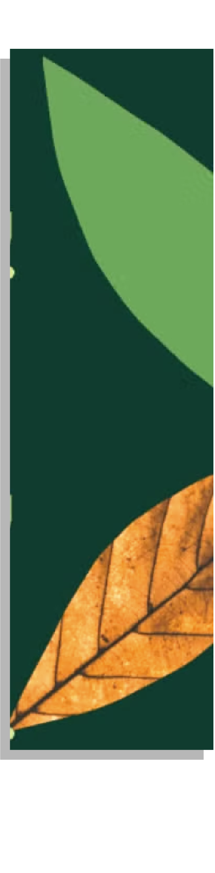

Potato farming faces significant challenges from diseases like early blight and late blight, which can cause major crop losses if not detected early. Farmers often struggle to identify these diseases promptly due to limited resources or expertise, leading to reduced yields and lower quality of produce.
Our Project aims to develop a mobile website that leverages Convolutional Neural Networks (CNNs) for image classification. The website will enable farmers to quickly and accurately determine if a potato plant is healthy or affected by early or late blight, providing timely
insights for disease management.

Slide 5
Agenda
1.Addressing Accessibility Gap
2.Enhancing Efficiency and Accuracy
3.Developing an Intelligent System
4.Contributing to Sustainable Agriculture
5.Empowering Data Driven Decisions
Conclusion and Call to Action.

Slide 6
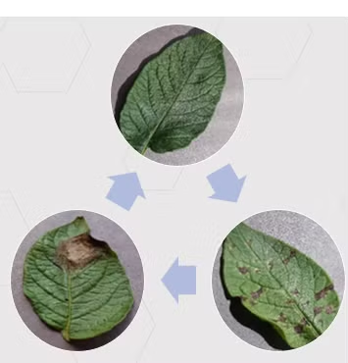
Introduction
Potato farming is vital to India's agriculture, but crops are highly vulnerable to diseases like early and late blight, which are difficult to detect with traditional methods. This project proposes a mobile website using Convolutional Neural Networks (CNN) for image-based disease detection. Farmers can take photos of potato plants and receive instant feedback on their health, enabling timely interventions to reduce crop losses and boost productivity.

Slide 7
Research Table :
Title | Author | Date | Remark
Potato Disease Detection Using Machine Learning. | Md. Marjanul Islam Tarik, Sadia Akter, Abdus Sattar, Abdullah Al Mamun. | N/A | This study focuses on the impact of potato diseases in Bangladesh and proposes a machine learning-based image processing system to detect and classify these diseases, which could help improve potato production and aid export potential, especially with over 99% accuracy in identifying disease from leaf images.
CNN vs. KNN for Image Classification | Khan et al | 2019 | CNNs consistently outperform KNN in medical image classification tasks, demonstrating their superior ability to extract meaningful features from complex medical images.

Slide 8
Title | Author | Date | Remark
AlexNet | Krizhevsky et al | 2012 | AlexNet revolutionized image classification by introducing a deep CNN architecture that achieved groundbreaking accuracy on the ImageNet dataset, setting a new standard for the field.
Going Deeper with Convolutions | Szegedy et al | 2014 | The Inception architecture introduced in "Going Deeper with Convolutions" significantly improved CNN performance by efficiently combining different convolution sizes and pooling operations, enabling deeper and more complex models.
Detection of Bacterial Leaf Blight Disease in Tomato Plants Using Deep Learning | Khan et al | 2020 | CNNs effectively classify tomato leaf images into healthy and diseased categories, achieving high accuracy and outperforming traditional methods.

Slide 9





Revolutionizing Plant Disease Detection with AI
AI Image Recognition
Utilizing advanced neural networks enables precise identification of crop diseases through image analysis. This technology enhances early detection, allowing for timely interventions and better crop management.
Disease Detection Accuracy
Achieves up to 95% accuracy in identifying diseases such as websitele scab.
Precision Irrigation
AI-driven irrigation systems enhance water usage efficiency by analyzing environmental conditions and plant needs. This technology optimizes watering schedules, reducing waste and improving crop health.
Plant Health Monitoring
Plant health monitoring involves tracking crop conditions to detect diseases and pests, ensuring optimal growth and yield.

Slide 10
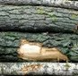
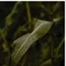

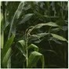
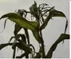
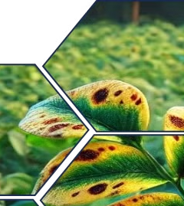
Critical Plant Diseases Affecting Crops
Early Blight Overview Caused by Alternaria solani, early blight leads to significant crop damage.
Late Blight Overview Phytophthora infestans is responsible for late blight, known for its rapid destruction.
Symptoms of Early Blight
Key symptoms include leaf spots, wilting, and potential plant death if untreated
Symptoms of Late Blight Late blight manifests through
water- soaked lesions and rapid decay of plant tissue.

Slide 11
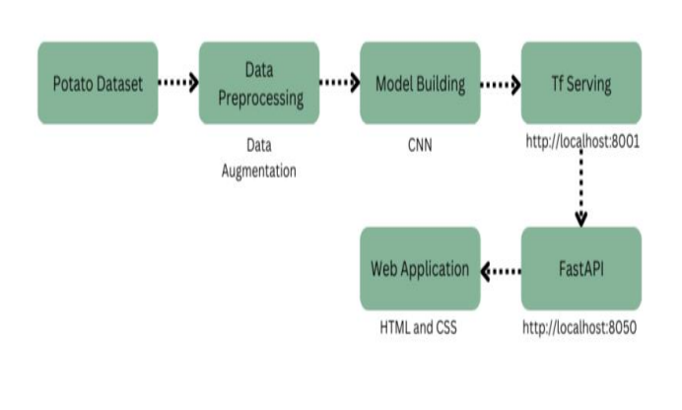
WORK FLOW :

Slide 12
How CNNs Work in Plant Disease Detection :
Convolutional Neural Networks (CNNs) are used in plant disease detection websites to automatically identify disease patterns in images. Farmers take a photo of a plant leaf, and the CNN processes the image through layers that detect features like spots, discoloration, or wilting. After feature extraction, the model classifies the plant as healthy, early blight or late blight.
CNNs are ideal for plant disease detection because they automatically learn important features, offer high accuracy, and can be deployed on mobile devices for real-time diagnosis. The model is trained on a large dataset of labeled images, and once optimized, can run efficiently offline to help farmers detect diseases early.
Additionally, CNNs help reduce the need for expert intervention, making disease diagnosis more accessible to farmers with limited technical knowledge. By offering quick, accurate results, the website enables timely intervention, helping prevent the spread of diseases and reducing crop losses.

Slide 13

CNN with Image Data Generator :
In plant disease detection websites, Convolutional Neural Networks (CNNs) are commonly used for image recognition. These algorithms automatically identify disease patterns in plant leaves by processing features such as spots, discoloration, and texture. CNNs are trained on large datasets of labeled plant images, learning to classify them as healthy or diseased (e.g., early blight, late blight).
The website uses image preprocessing to enhance photo quality, and models can run offline for real-time detection. Transfer learning techniques are often used to improve accuracy, making the website scalable for various crops and diseases.

Slide 14
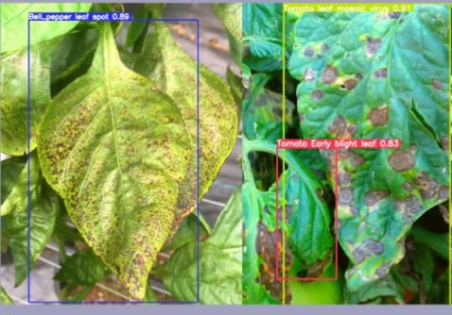
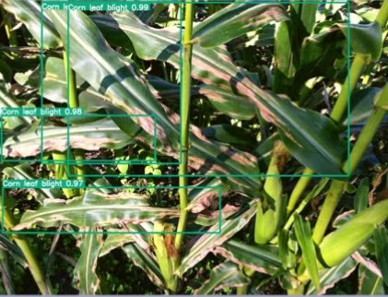
K-Nearest Neighbors (KNN) Algorithm: Simple and Effective Classification :
The K-Nearest Neighbors (KNN) algorithm is a simple, non- parametric machine learning algorithm used for classification and regression. It works by:
Classification : When given a new data point, KNN looks at the "K" closest points (neighbors) in the training dataset and assigns the class that the majority of these neighbors belong to.
Distance Measurement : The algorithm typically uses
distance metrics like Euclidean distance to measure how close data points are to each other.
Lazy Learning : KNN is a lazy algorithm, meaning it doesn’t learn a model during training but instead stores the entire training dataset and performs computation during prediction.
KNN is easy to implement and effective for small datasets

Slide 15
Comparison of CNN, KNN, and Image Generators :
Convolutional Neural Networks (CNN) : | K-Nearest Neighbors (KNN) : | Image Data Generator(Extended CNN) :
Image classification, feature extraction | Classification based on closest neighbors | Create synthetic images or data.
Accuracy : High for image recognition tasks. (88%) | Accuracy : Lower for complex images or noisy data. (65.4%) | Accuracy : Depends on quality of training and network architecture. (87%)
Computation : Requires high computational resources. | Computation : Low computational cost, easy to implement. | Computation : High computational cost for generating realistic images
Real-Time Usage : Efficient for real-time websites. | Real-Time Usage : Not ideal for real-time due to slow prediction speed on large datasets. | Real-Time Usage : Used for pre-training or dataset creation, not real-time.

Slide 16
Scope :
The project encompasses the development of a mobile website along with the necessary backend infrastructure to aid farmers in identifying diseases affecting potato plants. Key components of the scope include:
Model Development : Creating and training a Convolutional Neural Network (CNN) to accurately classify potato plant health based on image input.
Frontend Development: Develop the mobile website using HTML And CSS for cross-platform functionality.
Backend Server and ML Ops : Employ TensorFlow Serving for model deployment and inference. Utilize FastAPI to create a responsive backend server for handling requests.
The overarching goal is to provide an easy-to-use tool for farmers that enhances disease detection accuracy, ultimately reducing the impact of blight on potato crops and improving overall agricultural productivity.

Slide 17

Outcomes
Enhanced Disease Detection: Development of a reliable mobile website that enables farmers to accurately identify early blight and late blight in potato plants through image classification.
Increased Farmer Empowerment: Providing farmers with immediate access to information regarding plant health, allowing for timely interventions and improved crop management.
User-Friendly Interface: Creation of an intuitive mobile website that requires minimal training, ensuring accessibility for farmers with varying levels of technological expertise.
Valuable Data Insights:
Collection of data on disease prevalence, providing valuable insights for future research and improved agricultural practices.
Enhanced Community Awareness:
Increased awareness among farmers about the significance of proactive disease monitoring, promoting better agricultural practices.
Support for Sustainable Practices: Encouragement of sustainable farming by minimizing chemical interventions through early detection and effective management of diseases.

Slide 18

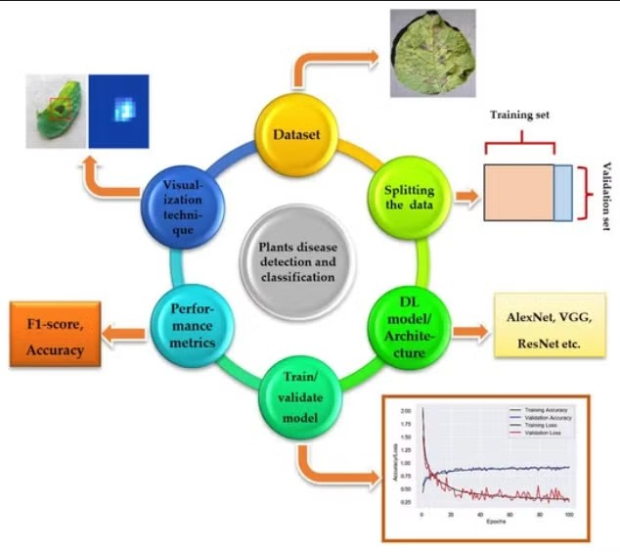
Test Case : Plant Disease Detection website
Test Case ID: PDD-001
Test Title: Image Upload and Disease Classification Objective:
Verify that the website correctly detects and classifies plant diseases (e.g., early blight, late blight) based on the uploaded plant leaf image.
•
•
•
The website is installed and functioning on a mobile device. The CNN model is pre-trained and integrated into the website. A dataset of healthy, early blight, and late blight images is available for testing.

Slide 19
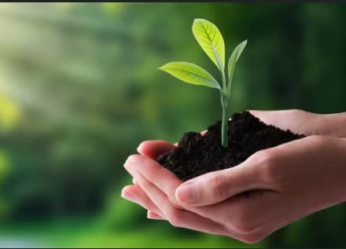
Test Scenarios :
Expected Results :
Positive Case (Valid Input):
Scenario: Upload an image of a plant with early blight symptoms.
Expected Result: The website correctly classifies the plant as early blight.
Negative Case (No Disease):
Scenario: Upload an image of a healthy plant.
Expected Result: The website classifies the plant as healthy.
Invalid Input:
Scenario: Upload a blurry or unrelated image (e.g., a photo of a non-plant object).
Expected Result: The website prompts an error or requests a clearer image.
The website should successfully:
Process the uploaded image.
Classify the plant as either healthy, early blight, or late blight.
Provide accurate results in line with the
labeled test dataset.

Slide 20
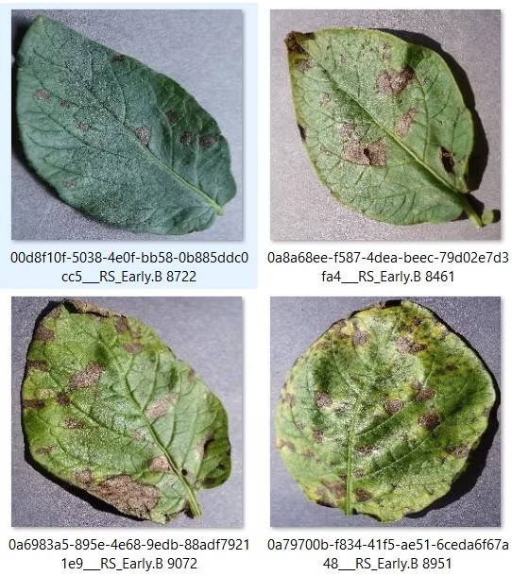
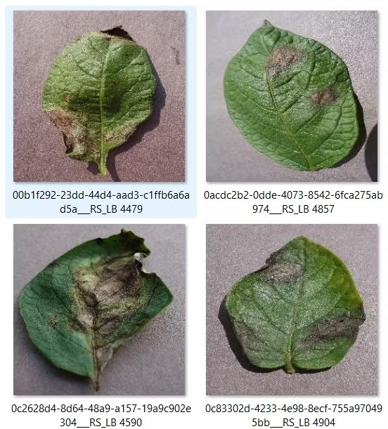
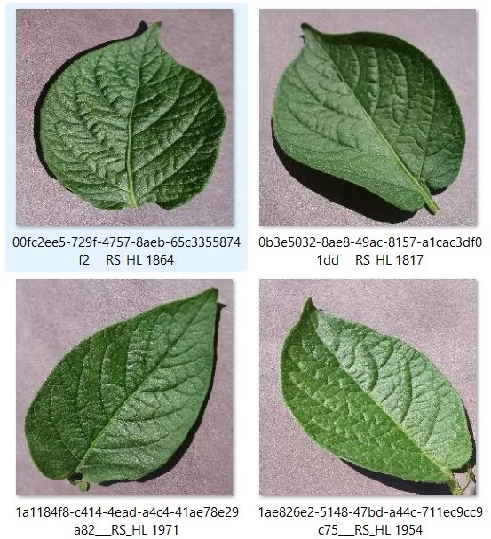
Sample Potato Leaves :
Early Blight
Late Blight
Healthy

Slide 21
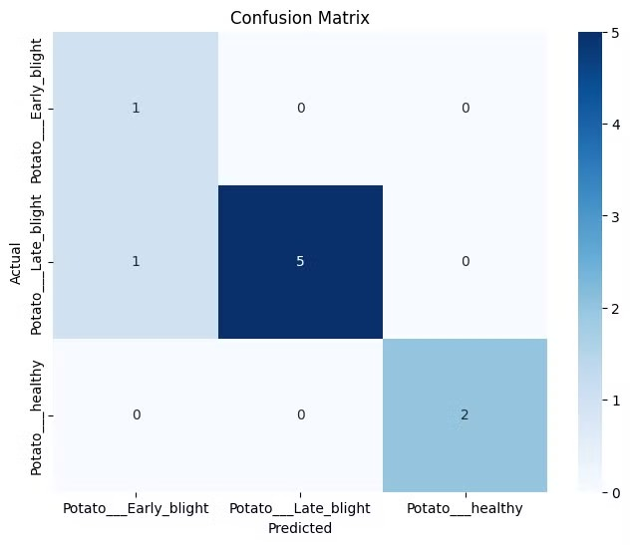
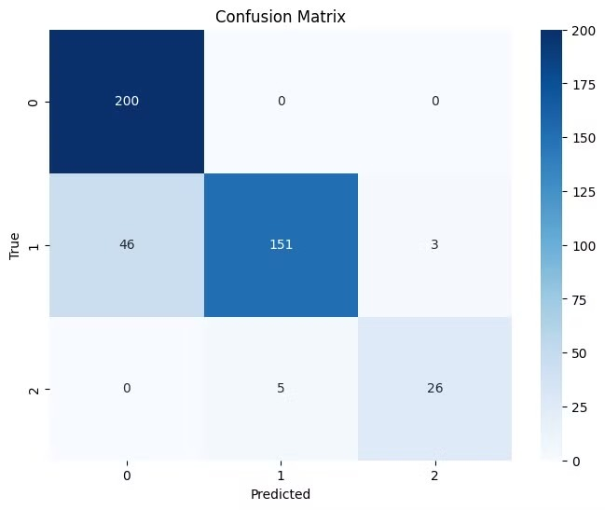
Confusion Matrix:
Standard CNN
CNN with Image Data Generator

Slide 22

Conclusion :
In conclusion, Our Project using Convolutional Neural Networks (CNNs) provides an effective solution for farmers to quickly and accurately diagnose diseases like early blight and late blight. By leveraging image recognition technology, the website offers real-time, offline functionality, making disease detection accessible even in remote areas. This project not only improves crop management and reduces losses but also empowers farmers with a user-friendly, cost-effective tool for enhancing agricultural productivity.
In addition, the website's scalability allows for the detection of multiple plant diseases across various crops, making it a versatile tool for diverse agricultural needs. By integrating advanced machine learning algorithms, the project bridges the gap between modern technology and traditional farming, promoting sustainable agricultural practices.

Slide 23
References :
https:/ .bing.com/search? pc=OA1&q=potato%20disease%20detection%20using%20machine%20learning%20research%20papers
https:/ link.springer.com/article/10.1007/s11042-022-13390-1 https:/ link.springer.com/chapter/10.1007/978-3-031-21216-1_46
https:/ .researchgate.net/publication/384619825_Potato_Diseases_Detection_Using_Image_Classification_Model s_in_Deep_Learning_Techniques
https:/ .mdpi.com/2077-0472/12/8/1192
https:/ .researchgate.net/publication/350539595_Potato_Disease_Detection_Using_Machine_Learning

Slide 24
Thank you.

